Slide 1
Scrapping GitHub website data and knowledge graph creation
Chandan Sharma

Slide 2
Project Overview
Objective: We wish to extract data from the GitHub’s repositories and create a knowledge graph for supporting analysis and building future recommendation system for GitHub users.
Methodology: We want to extract users contributing to specific repositories and find their followers.
In order to do so we use the Extract-Transform-Load design pattern.
In order to create a knowledge graph we use the Neo4j graph database.

Slide 3
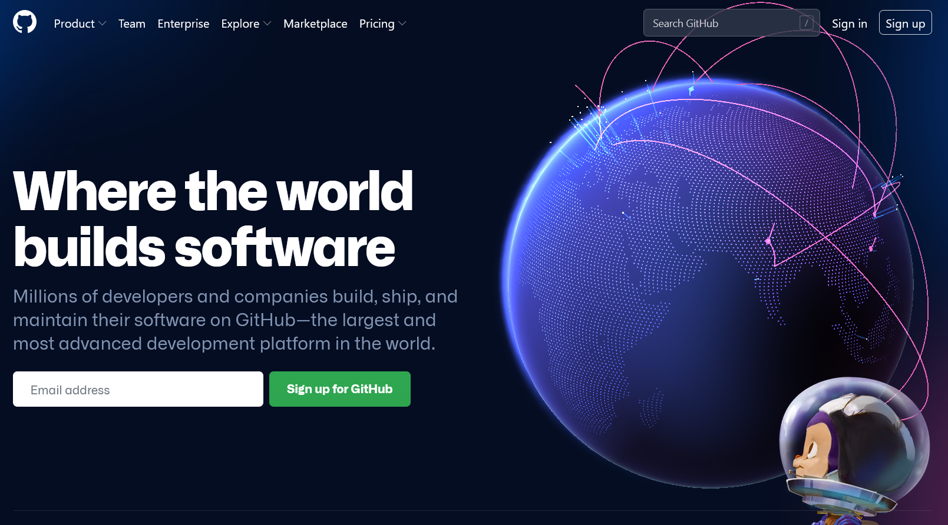
GitHub case study Overview
GitHub is an internet hosting service which provides support for software development and version control.
Multiple users (developers) can use this to collaborate and version control their projects.
As such there are multiple central themes to which users can contribute to

Slide 4
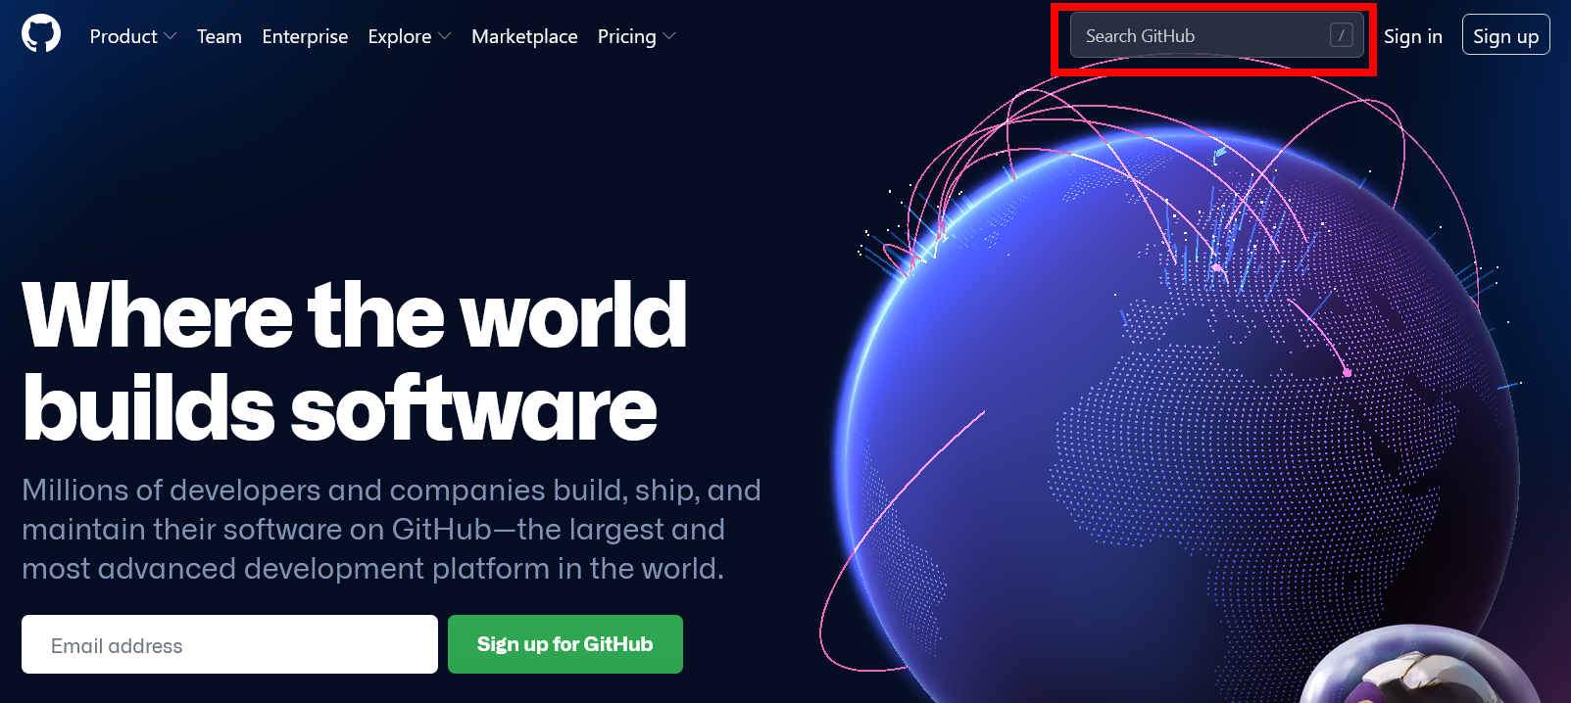
We can use the “Search GitHub” search bar for searching a theme under which certain repositories are grouped together.

Slide 5
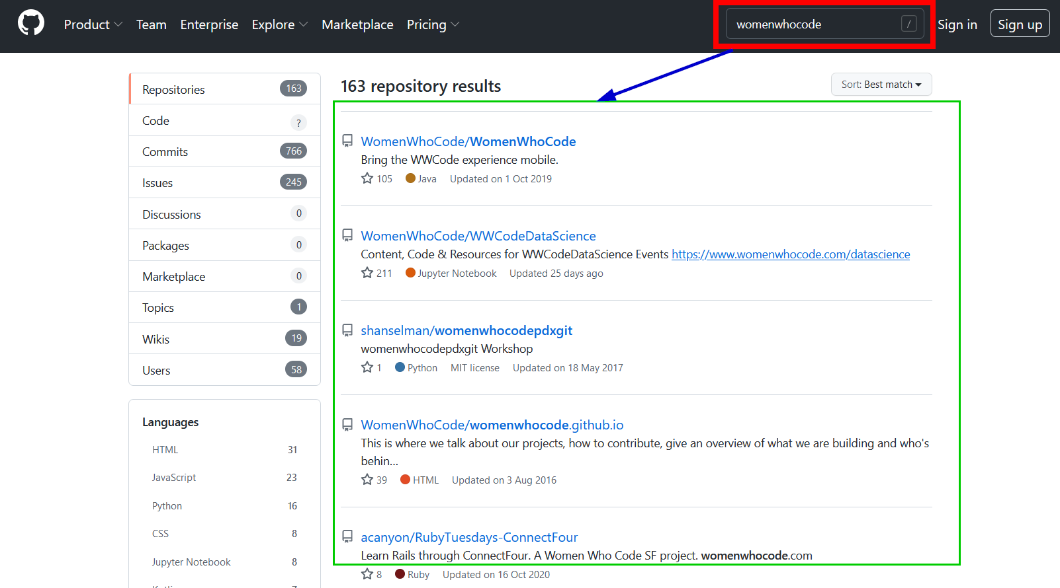
Searching for a theme “womenwhocode” gives us a total of 163 repositories.

Slide 6
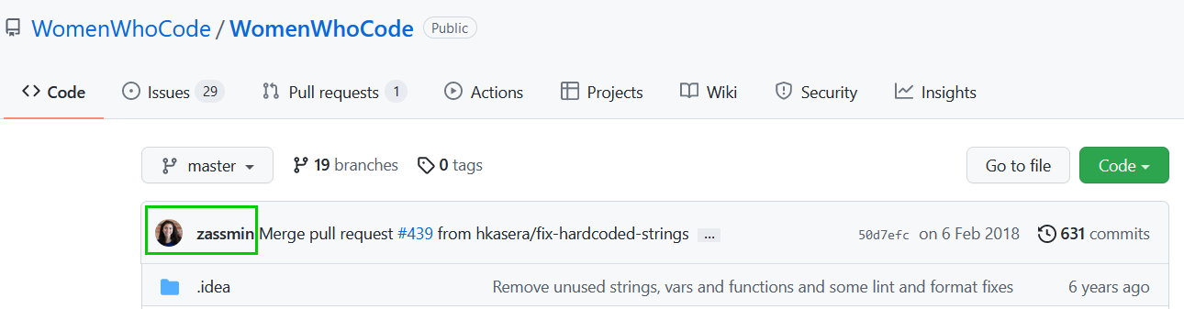
For the sake of simplicity we want to find out only the last person that committed to the project.
As shown in the image we know that person is zassmin.

Slide 7
As a user who is using the GitHub website.
We can observe that the webpage are linked to one another.
A user can navigate to different pages by clicking on the hyperlinks.
Intuitively we can think of these pages having some relationships to each other.

Slide 8
REPOSITORY
THEME
Is part of
Contributes to
USER

Slide 9
Project objectives revisited
In this project we wish to obtain this data from the GitHub website.
Convert this data in a machine readable format.
Model this data as a graph database.
Why a graph database.
Why graphs!!!!

Slide 10
Why Graph and Graph Databases ?
Graphs provide a natural and intuitive way of modeling highly connected data.
Data can be modeled as humans think of them.
For example,
A user contributed to a repository
A repository is part of a theme
Graph database solutions such as Neo4j provide means to store data as a graph.
By modeling data as a graph we can use powerful graph algorithms such as community detection, centrality detection for data analysis.

Slide 11
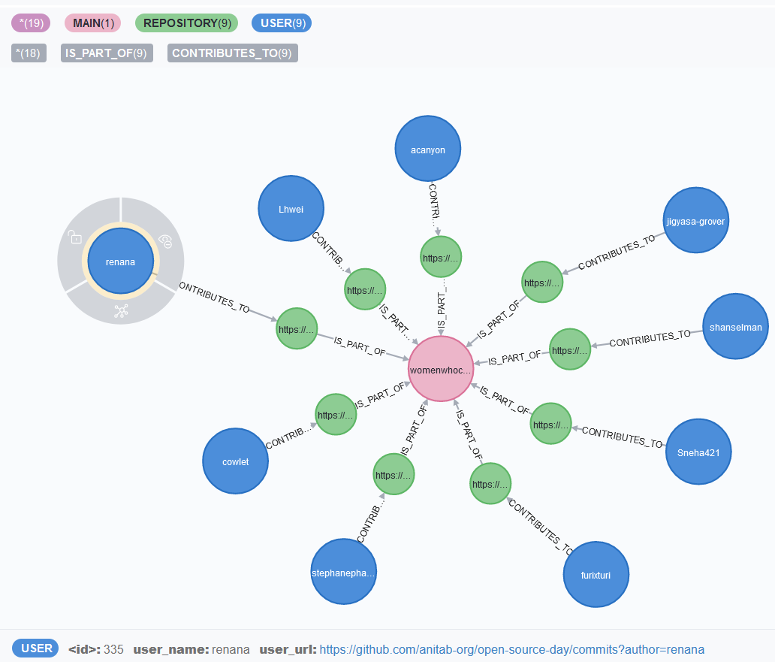
GitHub graph database : Our end goal
By the end of this project we wish to:
Create a GitHub graph database
The graph database is based on Labeled Property Graph Data Model
In this graph we have meta data stored inside nodes and edges as Key-Value pairs.

Slide 12
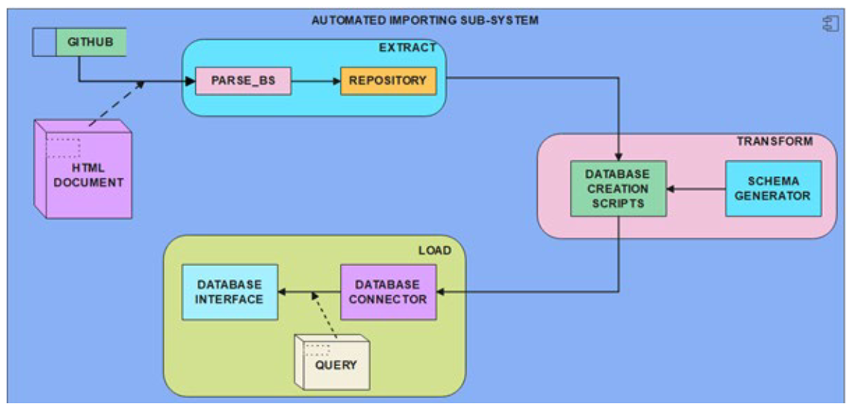
Software architecture
In order to create this project we will use the Extract-Transform-load design pattern.
The diagram shows the flow of the software by using an UML Data Flow Diagram.

Slide 13
Software architecture
The first stage is the Extract module which is used to obtain data from GitHub website.
The input is an HTML document and the extract module has two important components
Parse_BS and Repository

Slide 14
Software architecture
The second stage is the Transform module.
In this module database creation scripts are created based on the input obtained from the Extract module.
We also use a separate module called as schema generator
But a schema generator module is an advanced topic.

Slide 15
Software architecture
The third and last stage of the software lifecycle is the Load module.
This module gets the database creation script from the transform module as input.
This module forms a connection with the graph database and executes the database creation script.

Slide 16
Getting started with the Extract module
The Extract module also has objectives.
Objective 1: To fetch data from the GitHub website based on a particular Theme.
Objective 2: Once the data has been fetched we wish to scrap the html page.
Objective 3: The final objective of the Extract module is to create a repository or a staging area.
This staging area can then be used to provide input to the Transfrom module.

Slide 17
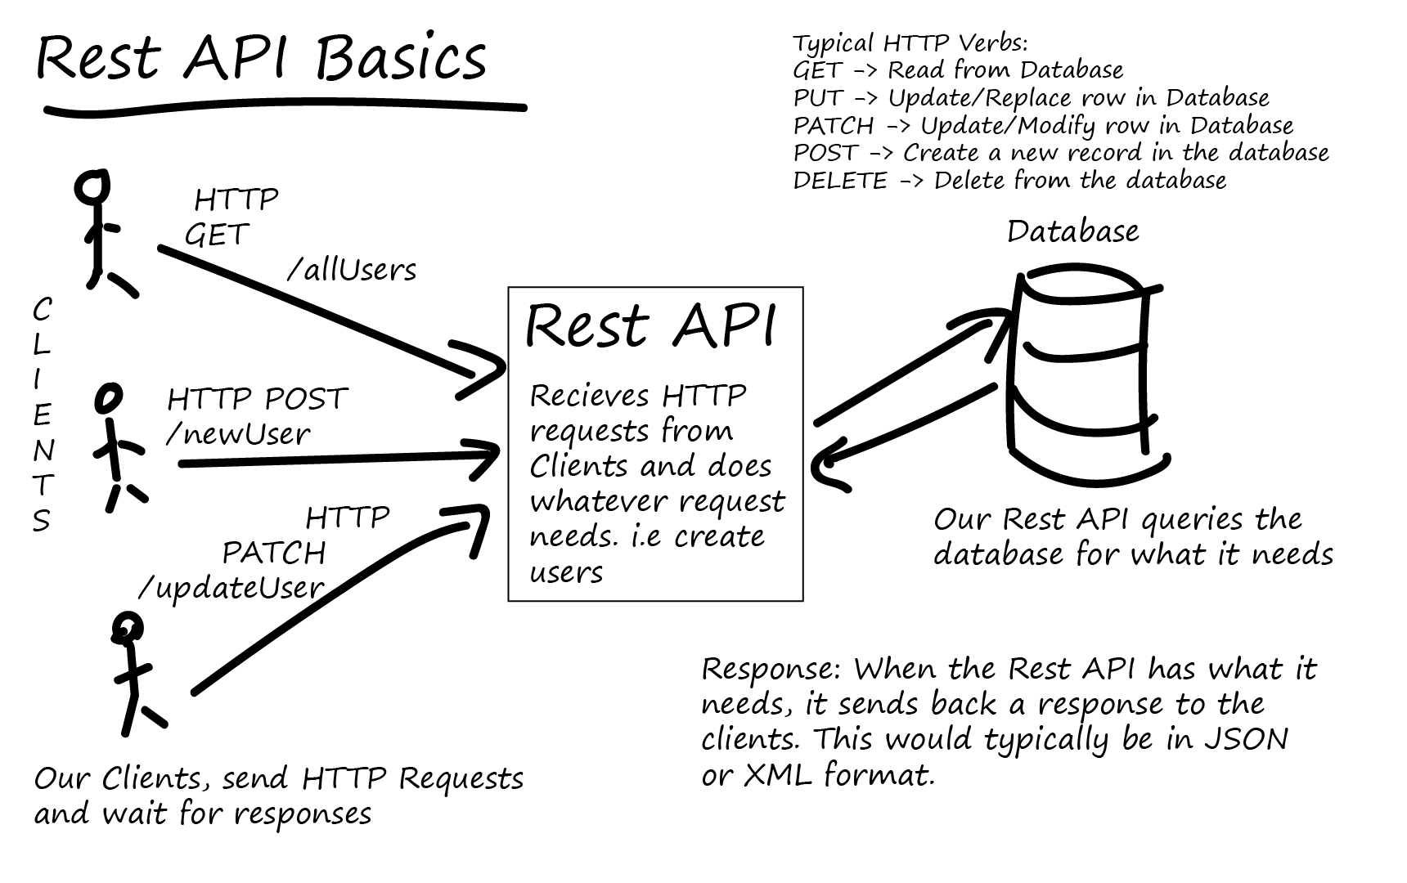
Extract module: Objective 1
We use the RESTFUL API for fetching data from the GitHub Website.

Slide 18
Objective 1 fulfilment: GET Request
In order to fulfill the objective 1 we require the RestAPI Get method.
GET request:
Is used to retrieve resource representation/information only
Not modify the data in any way
As GET requests do not change the resource’s state, these are said to be safe methods.
GET APIs are idempotent.
Making multiple identical requests must produce the same result every time until another API (POST or PUT) has changed the state of the resource on the server.

Slide 19
Objective 1 fulfilment: GET Request Response Code
For any given HTTP GET API, if the resource is found on the server, then it must return HTTP response code 200 OK
Along with the response body, which is usually either XML or JSON content (due to their platform-independent nature).
In case the resource is NOT found on the server then API must return HTTP response code 404
Similarly, if it is determined that the GET request itself is not correctly formed then the server will return the HTTP response code 400 (bad request)

Slide 20
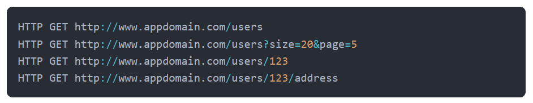
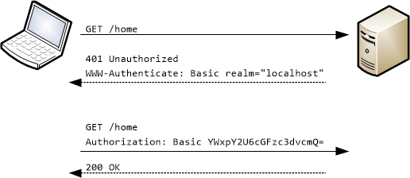
GET Request examples

Slide 21
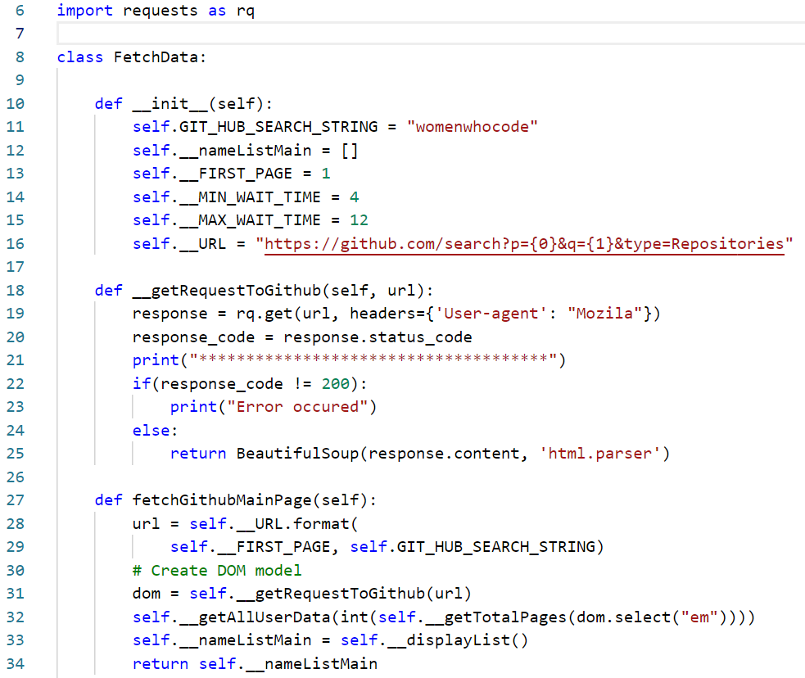
Project code for GET Request
In the code we import the requests module in line 6. This module is used to send RESTFUL web requests from Python code.
In line 18, we the calling the static get method provided by request library.
This method takes the url that we wish to search for and a dictionary of headers as input.
Incase the request code is 200 the method returns an HTML page

Slide 22
Quick recap
Before moving ahead let us take a few moments to analyze the code.
What can be observe??
What does self.__URL represents.
How is the self.__URL string being formulated??

Slide 23
Project code for GET Request
As shown in line 22-25 incase the request code is 200 the method returns an HTML page.
The get method returns result set in form of a JSON file.
We need to convert this page into a HTML format so that we can scrape the GitHub HTML page.
Hence we require another python library called as Beautiful soup.

Slide 24
Web scraping in Python: Beautiful soup
Beautiful soup is a Python library for pulling data out of HTML and XML files.
It works with your favorite parser to provide idiomatic ways of navigating, searching, and modifying the parse tree.
It commonly saves programmers hours or days of work.
For this project we are using Beautiful soup for pulling data out of HTML page.
pip install beautifulsoup4

Slide 25
Web scraping in Python: HTML
HTML : Hyper Text Markup Language
HTML is a structured language that is used to describe and formulate the structure of a web page.
HTML comes from a long history of markup languages such as
GML
Generalized Markup Language
SGML
Standard Generalized Markup Languages
XML
eXtensible Markup Language

Slide 26
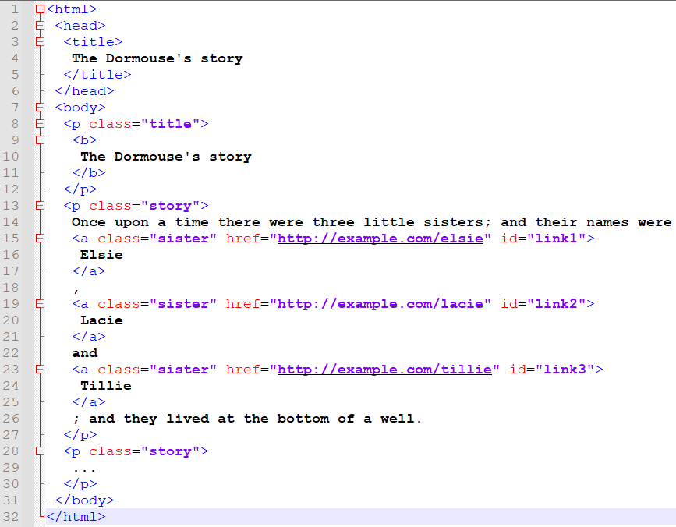
Given a simple HTML document.
We can use beautiful soup for pulling data out of the HTML page.
Beautiful soup library in python reads the entire HTML document
And provides methods to access the data based on the HTML tags.

Slide 27
Given a simple HTML document.
We can use beautiful soup for pulling data out of the HTML page.
Beautiful soup library in python reads the entire HTML document
And provides methods to access the data based on the HTML tags.

Slide 28
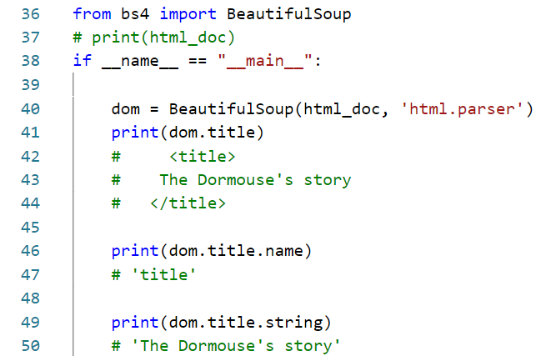

Slide 29
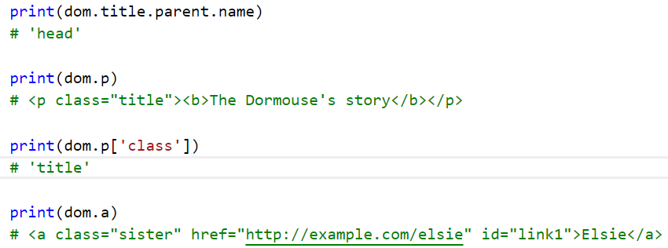

Slide 30
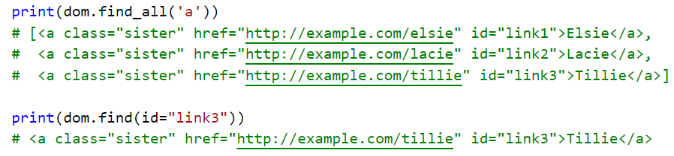

Slide 31
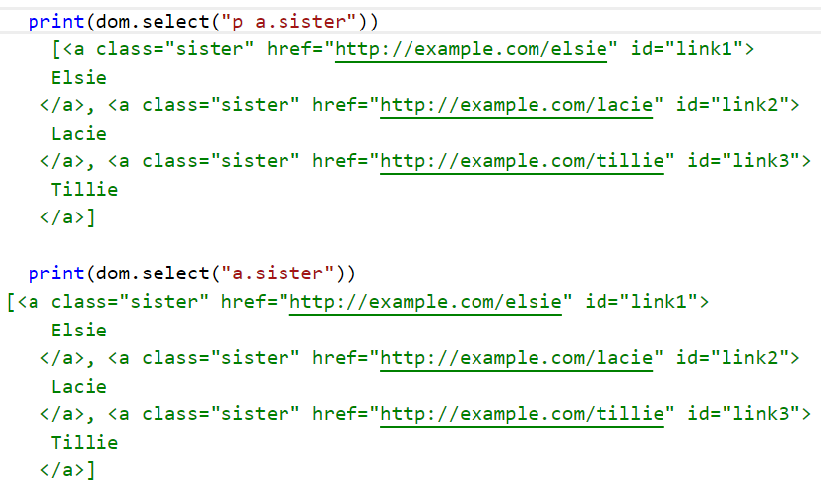

Slide 32
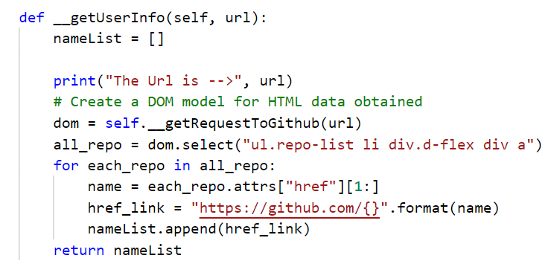
Extract module: Objective 2
The method __getUserInfo(self, url)
Uses the select method to search for the repository names.
But in the search string a pattern has been specified.
The pattern is used to search for the repository names.
But why???

Slide 33
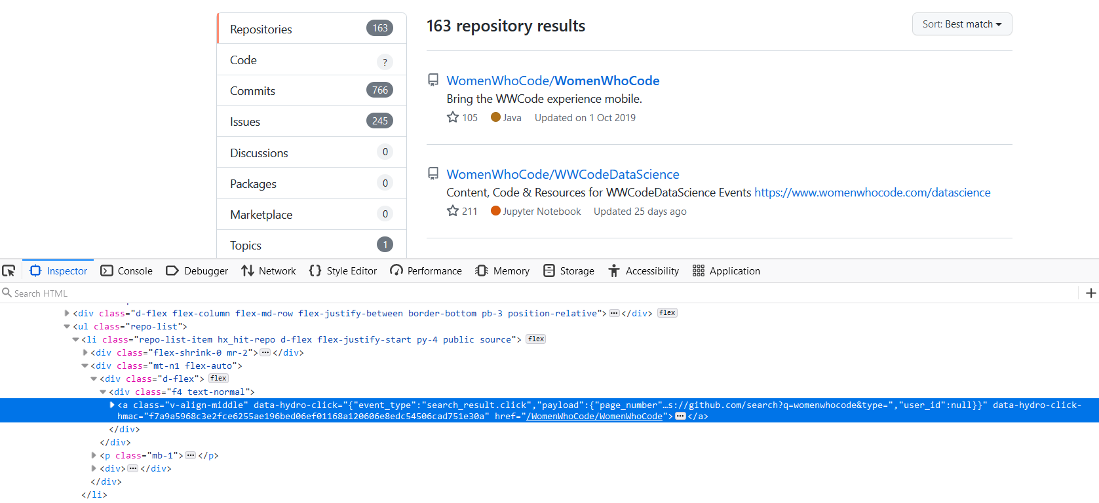
If we inspect the HTML source code behind the link “WomenWhoCode/WomenWhoCode”
We can observe that the link in embedded inside the ul → li → div → div → a tag.

Slide 34
Extract module: Objective 2
The code here is actually doing the same thing.
The dom variable is used to store all the tags that follow the hierarchy.
Then we are iterating over the all_repo variable which holds a list.
We are only interested in finding the contents associated with the href attribute.

Slide 35
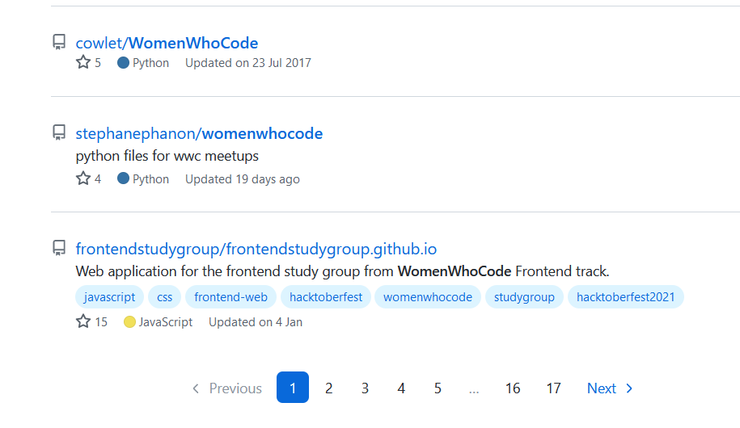
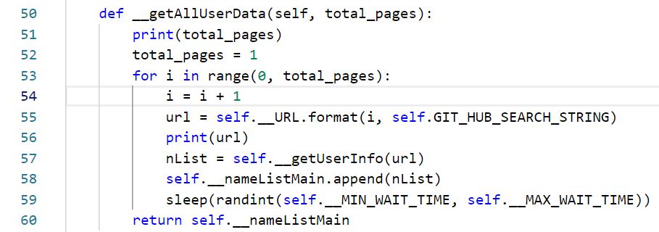
Randint function and logic to extract all pages
There exist multiple pages containing information about various repositories.

Slide 36
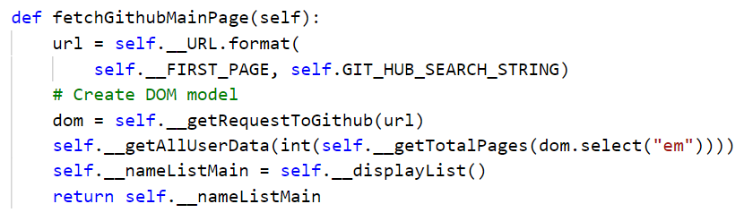
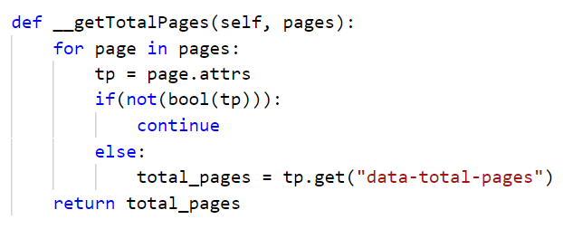
Randint function and logic to extract all pages

Slide 37
Randint function and logic to extract all pages
We need to put an interrupt while scraping data from multiple webpages on GitHub.
That is why we need a Randint function.
This function generates a random number between 2 and 8
The for loop after fetching data from one page holts for a while.

Slide 38
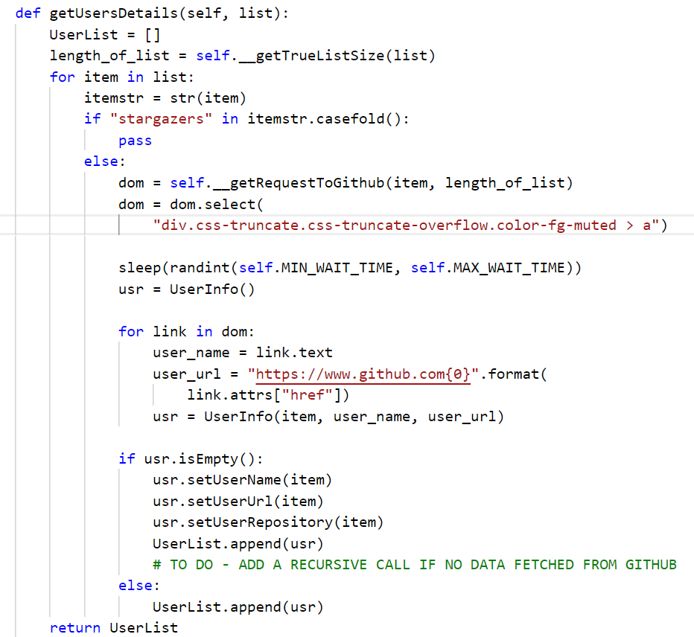
Extract Module: Objective 2 → Fetch user data
We now wish to fetch user specific data.
In this code we are not looking at the stargazers repository.
We are using the same logic for searching the element in the HTML document.

Slide 39
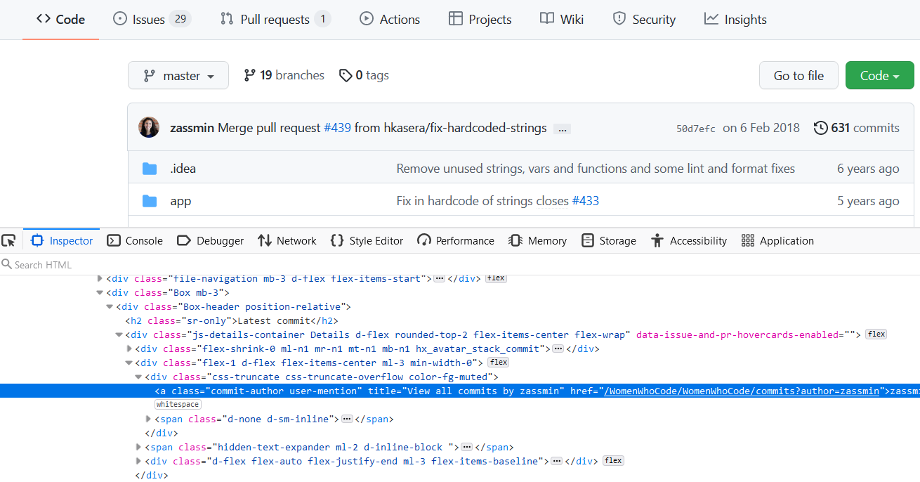

Slide 40
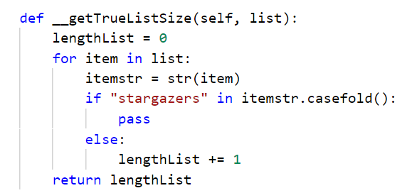
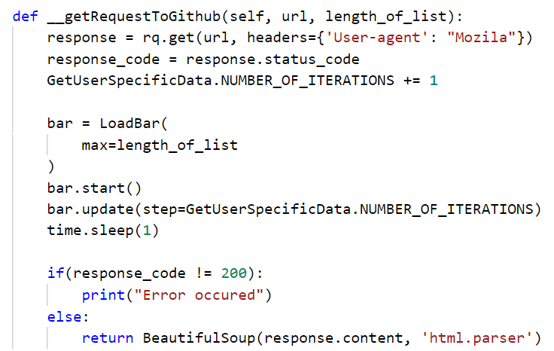
Discussion: Let us try to understand the code

Slide 41
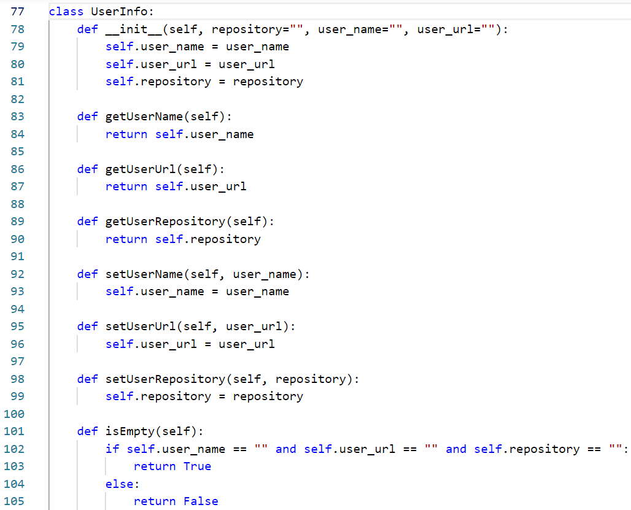
One thing to observe is that I have created a UserInfo object in code.
This is actually created to organize the data and create a matching entry for user repository, user url and user name.
This assists in creating a user defined data type and is used while creating a staging area.

Slide 42
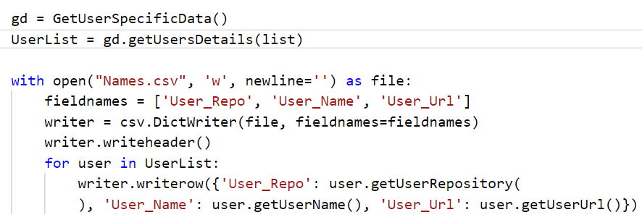
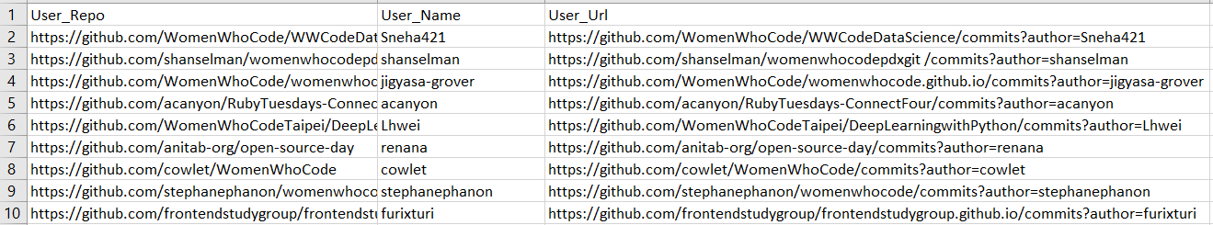
Extract module: Objective 3 → Creating a staging area

Slide 43
Why do we need a staging area
The staging area serves as a medium for other processes to interact with the scrapped data.
By using a staging area we can extract data once and use it over and over again for uploading and formulating a database.
Especially this can be useful while working on the development of the project.
In our case we use a csv file for staging.
Another advantage of staging area is that we can develop the logic for transform module in some other language such as Java.

Slide 44
Getting started with the Transform module
The Extract module also has objectives.
To read the data present in the staging area
Creating a database generation script.
In our case we use graph databases
Hence, the transform module is used to generate a graph database creation script.

Slide 45
A gentle introduction to Graph databases
A graph database stores nodes and relationships instead of tables, or documents.
Data is stored just like you might sketch ideas on a whiteboard.
We live in a connected world, and understanding most domains requires processing rich sets of connections to understand what’s really happening.
Often, we find that the connections between items are as important as the items themselves.

Slide 46
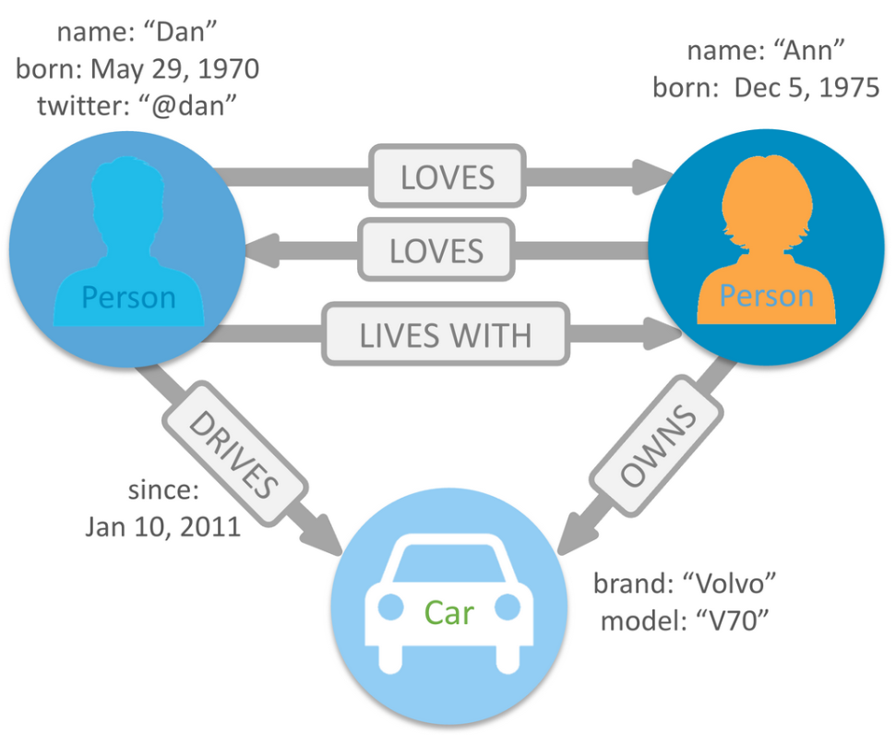
A graph database stores nodes and relationships.
Nodes and relationships store information as key-value pairs.
The data model is called as the property graph data model.

Slide 47
Cypher Query Language
Cypher is Neo4j’s graph query language that lets you retrieve data from the graph.
It is like SQL for graphs, and was inspired by SQL so it lets you focus on what data you want out of the graph (not how to go get it).
It is the easiest graph language to learn by far because of its similarity to other languages, and intuitiveness.
Cypher is unique because it provides a visual way of matching patterns and relationships.
Cypher uses ASCII art (:nodes)-[:relationships]->(:other_nodes)

Slide 48
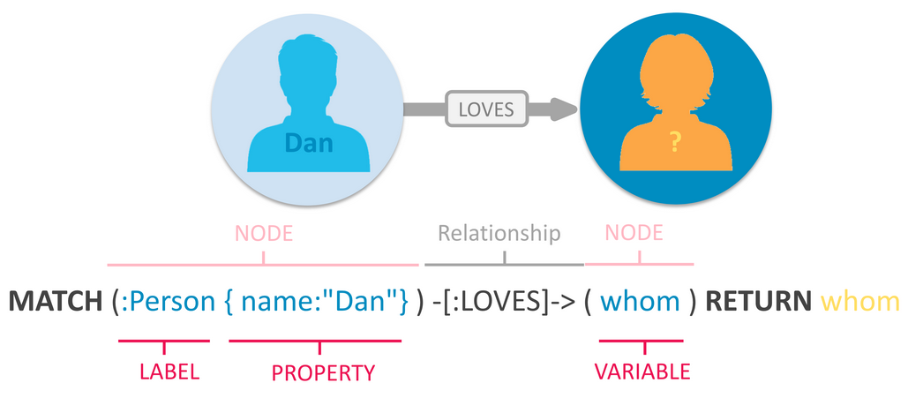
Cypher Query Language

Slide 49
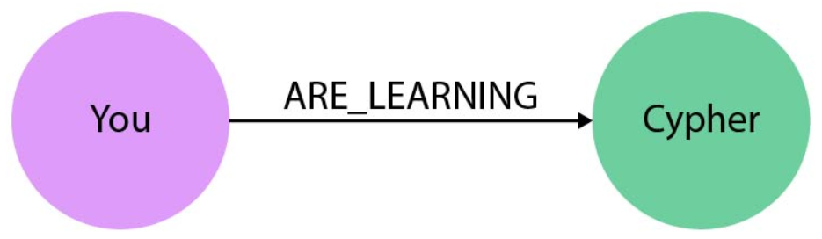
Cypher Query Language
As users we specify patterns.
Patterns are graphs that are specified by a user for extracting data from a graph database.
We can specify the following pattern
Match (You:PERSON)-[:ARE_LEARNING]->(Cypher:LANGUAGE)

Slide 50
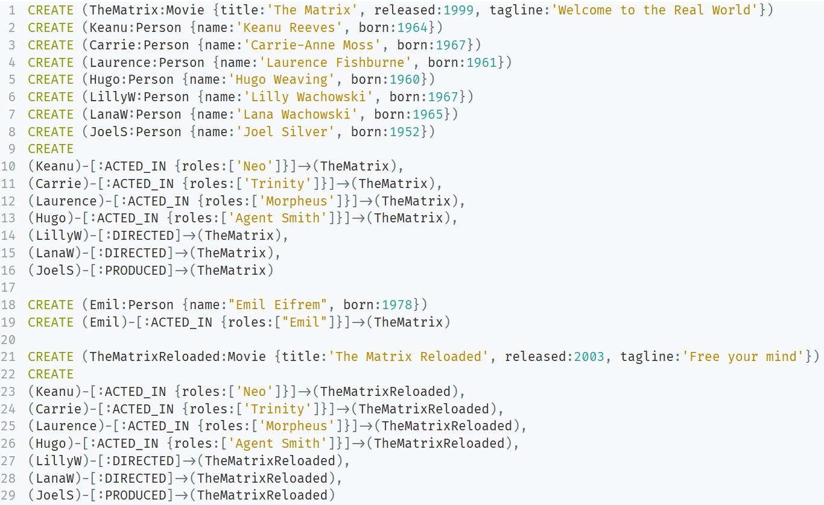
Cypher Query Language: Creating a Movie Database

Slide 51
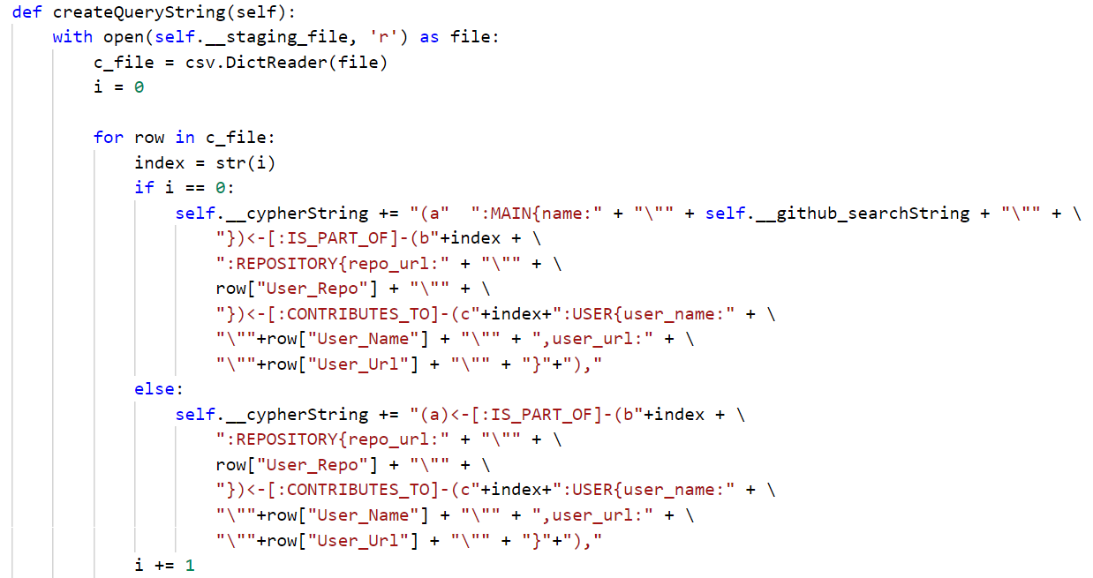
Transform module: Creating a database creation script

